Slide 1
Mitigating the impact of network asymmetry November 6, 2018
Michael Mayer
Huawei Canada Research Centre

Slide 2
Introduction
Outline:
Background
Reference architectures and accuracy requirements
Sources of asymmetry
Methods of dealing with asymmetry
summary

Slide 3
Asymmetry: the Achilles heel of time transfer
Two way time transfer by the exchange of time-messages is a well understood method of synchronizing two remote clocks.
NTP
PTP
Satellite
Interest is now the distribution of time over a network of clocks
Industry focus is on PTP
High performance, low relative cost, broad applications
Industrial automation as the impetus, seen as valuable for Telecom, more accurate than NTP for new data centre applications.
All basic methods share the same assumptions of symmetric path delay.
Correct assumption for many applications
Some consideration needed when pushing the limits
Increasing accuracy achievable

Slide 4
Asymmetry and PTP offset calculations
d_{ms}
M
S
M
S
T₁
T₂
d_{ms}
d_{ms}≠d_{sm}
T₃
d_{sm}
T₄
d_{sm}
T₄
d_{sm}
Classic PTP message exchange: slave can calculate its offset from the master:
T₂=T₁+d_{ms}+Offset_{SM} (1)
T₄=T₃+d_{sm}-Offset_{SM} (2)
Combining (1) and (2):
Offset_{SM}=(T₂ – T₄ – T₁ + T₃ )/2+(d_{ms} – d_{sm} )/2
Offset_{SM}=(T₂ – T₄ – T₁ + T₃ )/2
Error due to asymmetry

Slide 5
Is Asymmetry a problem?
Time distribution requirements vary based on application
Telecom (e.g. 10’s of nS to microseconds)
Finance (e.g. MiFID – 100microseconds, absolute, relative to UTC)
Fibre asymmetry will lead to an error of about 2 nS for each meter of cable asymmetry.
Telecom looks like the more stringent requirement,
Finance needs to consider the entire distribution path.
Clock models/architecture differ
As PHY devices gets more complex, more sources of asymmetry may exist
WDM/TDM system (e.g. OTN)
Rate mis-match in non PTP-aware network elements.
Asymmetry due to optical modules
Combined sources of asymmetry could reach 10 nS
Impact needs to be assessed relative to time accuracy requirements and expected deployment.
Two examples follow:
Wireless backhaul
High accuracy core timing distribution

Slide 6
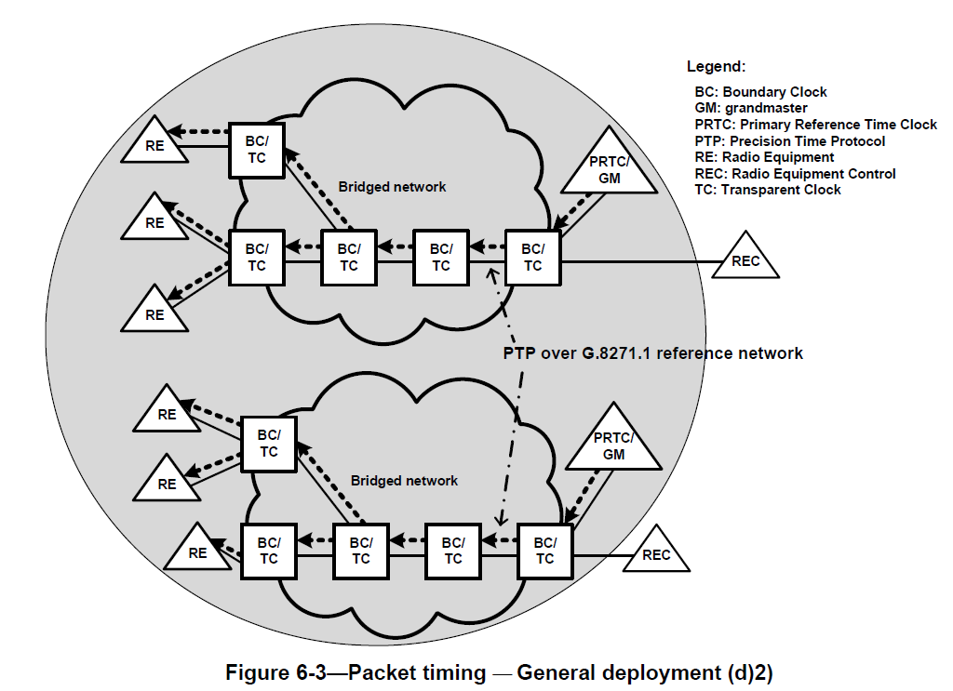
Reference architecture: Telecom 1
Key application of interest is related to wireless backhaul/fronthaul.
Technology assumed to be all Ethernet with Telecom boundary clocks present.
Asymmetry issues?
Manageable with appropriate network design.
Care needed when carrying links over TDM/WDM or high speed links
Radio CRAN may share similar issues to Data center and Finance.

Slide 7
Reference architecture: Telecom 2
cnPRTC: Coherent network (Connected Enhanced) PRTC
Intended for providing a highly accurate clock time distribution network
Operates at the core (compared with RAN)
Characterized by a few specialized nodes (CnPRTC)
Figure: Draft version of G.8275, Oct.2018

Slide 8
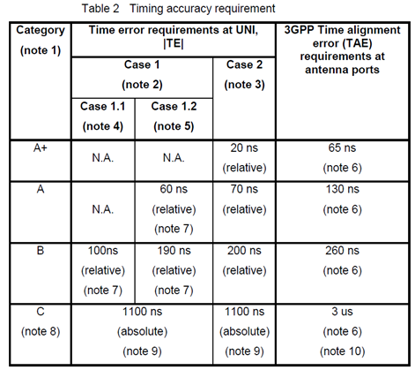
Accuracy requirements
Accuracy requirements vary based on specific use categories
General assumptions for end-to-end accuracy for wireless can be very stringent
Some assumptions for error due to asymmetry are between 20 nS and 40 nS, which are in the order of the time error requirement.

Slide 9
Accuracy requirements
Clock requirements are based on end-to-end system requirements to support use categories.
New classes of clocks are being developed for high performance systems define a time budget
Includes constant and dynamic time error (cTE and dTE)
Asymmetry must be controlled
Looks like cTE
 | Parameter |  | T-BC, T-TSC |  |  |  |  | Unit
 |  |  | Already specified |  | Proposed new values
 |  |  | Class A | Class B | Class C | Class D | Class D+
Performance requirements | maxITEI | unfiltered | 100 | 70 | 20-22 | 10 |  | ns
 | cTE+dTE_{L} |  |  |  | 15 | 8 (9?) | 5 | ns
 | cTE |  | 50 | 20 | 8 | 5 (7?) | 4 | ns
 | dTE_{L} (MTIE) | constant temp. up to 1.000 sec | 40 | 40 | 10 | 5 (3?) | 2 | ns
 |  | var. temp. up to 10.000 sec | 40 | 40 | FFS | 5 (to be confirmed) |  | ns
 | dTE_{L} (TDEV) | constant temp. up to 1.000 sec | 4 | 4 | 2 | 1 |  | ns
 | dTE_{H} | up to 1.000 sec | 70 | 70 | 20 | 10 |  | ns

Slide 12
Sources of asymmetry
Unequal fibre length has generally been assumed to be the main source of asymmetry in PTP.
Error due to asymmetry: ~2 ns/m
If known, PTP messages have the ability to transmit this value within the PTP message.
Requires measuring, not within scope of standard
Recall that PTP is intended for industrial automation
Fibre directly connects devices
Other network elements may have some impact, some of which can be addressed by equipment design, network design or standardization
Example cases:
PTP Boundary Clocks
Intermediate “server” network equipment (PTP as a client carried over a server network)
Optical modules (e.g. PAM-4 modulation)
Laser wavelength
Unequal transmission speeds
Message processing delays

Slide 13
Sources: PTP processing
PTP application
Layer
PTP operates as an application mapped using UDP/IP to provide time
Frequency (syntonization) may be provided at the PMA layer as shown (e.g. Sync Ethernet)
Data link, network and transport layer can contribute to latency variation
PHY may be more complex (e.g. PAM-4) or mapped to a server layer (e.g. OTN).
For Telecom, many aspects are controlled in the specification stage (e.g. IEEE802.1CM)
Improve accuracy with
hardware timestamping
Special hardware
PTP
Transport
UDP
Network
IP
LLC
Data link
Layer
MAC control
Hardware
Assist
MAC
Reconcilliation
MII
“PHY
Device”
PCS
PHY layer
PMA
PMD
AN
Medium
Timing path
(time/phase)
Timing path
(Frequency)

Slide 14
Sources: Intermediate transport
Mapping of PTP (Ethernet) clients over OTN is possible.
Buffers in TDM equipment will add some latency
Latency may differ after restart restart, or reframe (e.g. protection event)
Current approach is to use OSC to carry time stamp information
PTP
PTP
PTP application
Layer
UDP/Ethernet
UDP/Ethernet
PTP Equipment
Ethernet PHY
Layer
OTN
Network
Ethernet
Mapper
Ethernet
Demapper
OTN Layer

Slide 15
Sources: Optical modules
“low rate” optical interfaces use direct modulation.
New high rate systems such as 50Gbit/sec, 100Gbit/s and above use multi-level modulation, or coherent modulation.
Modules may incorporate components/functions that will add some latency
Recent figures show maximum variability in the order of 70nS
(reference Juniper/Huawei

Slide 16
Sources: Asymmetry due to laser wavelength
Propagation of a wavelength through a fiber will experience PMD
Governed by Sellmeir equations
may have implications on
single fibre SFPs,
higher rate modulation
WDM transport
Tx
Fibre
Tx

Slide 17
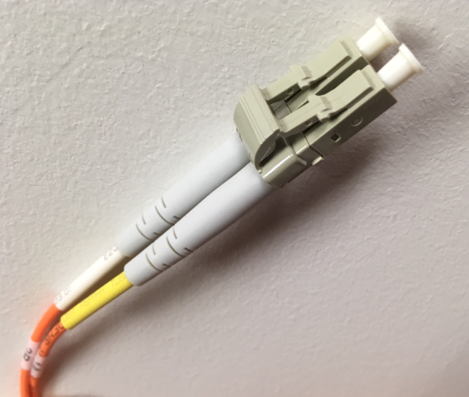
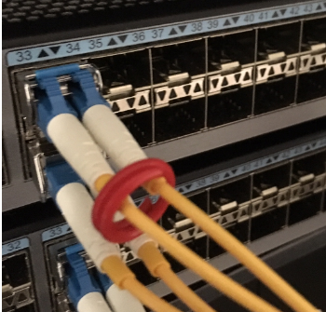
Some methods to cope with asymmetry
Single fibre (bi-directional) interfaces
Fibre switching
Planning
Develop appropriate asymmetry budget based on anticipated requirements
Develop consistent practices

Slide 18
Methods: Single bidirectional fiber
Recall: asymmetry due to different wavelengths
Single fibre SPF:
One fibre for transmit and receive
Similar issues to WDM (previous slide)
Key factor: removes any impact due to unequal fibre lengths,
But still provides some error
Can be acceptable in many situations, especially when low rate connections are needed.
Note, White Rabbit adds additional functionality not discussed here. This covers the case when only an SFP in a system is replaced.
Tx
Tx
Fibre
Fibre
Rx
Tx

Slide 19
Methods: Possible use of external switch
Control
Control
d₁
(4)
(3)
M
S
(2)
(1)
Control (Transmit)
Master needs to send message to slave switch (1)
Master then needs to wait for ack then switch master switch (4)
Control (receive)
Needs to detect control packets (2)
Ack or decline
Then switch slave switch (3)

Slide 20
Mitigation strategies: Summary
Fibre switching | Bidirectional fibre | High speed optics | Intermediate transport | Planning
-Non-standardized methods -Useful in cases where very accurate time distribution is required -Requires manual interface to PTP systems -Usually only on system initiation | -solves many issues with asymmetric fibre -Asymmetry still possible due to different wavelengths -fewer choices in SFP options (reach, speed) hence possible higher cost | -currently optical modules introduce some latency -Issue new, expect more control as interfaces mature. -need to be aware of and avoid usage when very high accuracy time-distribution is required | -will add some delay asymmetry, -develop a network budget to accommodate -use OSC based solution for time-distribution when required | -Treat timing as an infrastructure -develop “comfortable TAE budget” -Develop consistent engineering rules -use Hardware assist where available,

Slide 21
Summary (1)
Delivering accurate time is required in both telecom and financial environments.
Achieving target performance requires care, but it is not impossible.
Performance requirements have been elusive but are now stable targets
The output of various standards bodies will produce solutions that are reasonable in terms of cost and being capable of meeting future service requirements.

Slide 22
Summary (2)
Overall performance (time accuracy) is dependent on equipment capability and network design
Asymmetry is one known contributor to timing error, but this can be avoided largely by developing and following simple and consistent design guidelines
Create specific rules for sync distribution in DCs (and CRAN) to develop rules to ensure that costly measurements can be avoided and consequently rules that tell you where you should measure.
Understand the requirements: absolute time or relative time
Is your environment capable of meeting both cases?

Slide 23
Thank you
(Some backup if needed)

Slide 24
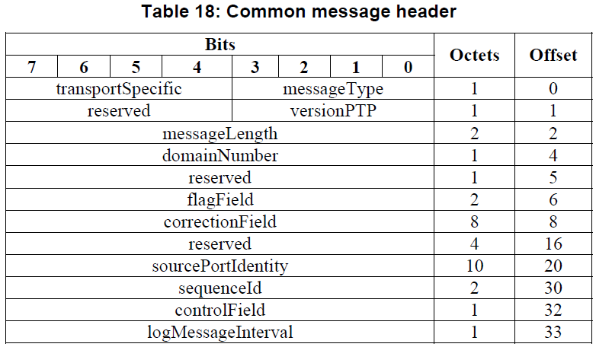
Correction field in IEEE 1588

Slide 25
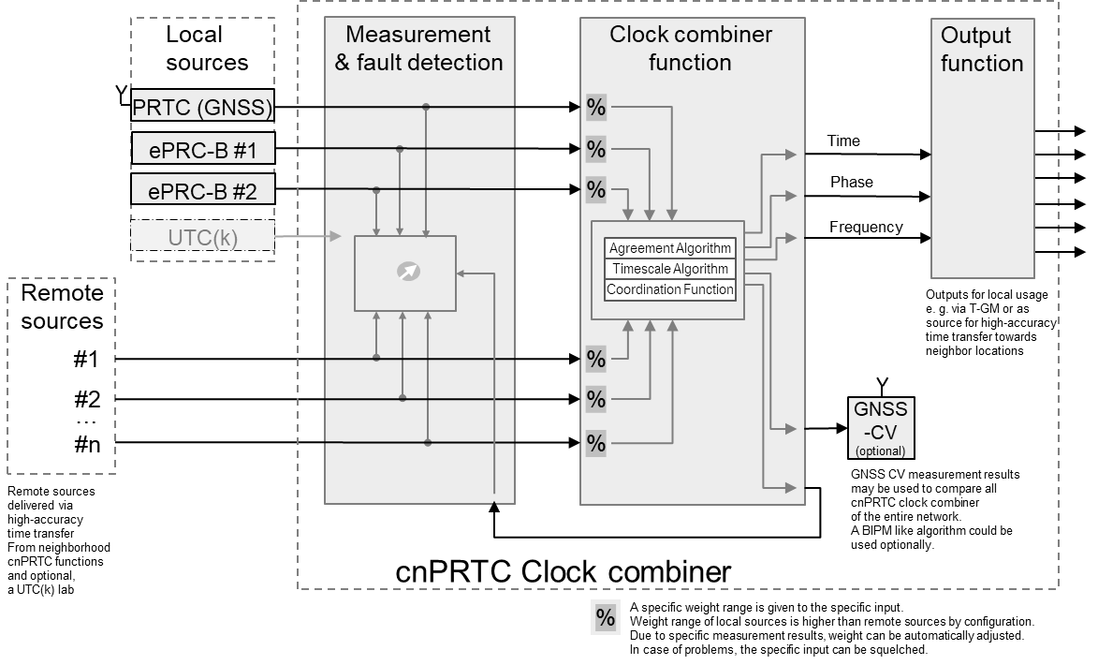
Clock combiner used in cnPRTC

Slide 26
Data Centres
Data centre architecture presents some challenges
Different classes, wiring systems (e.g. structured)
Scale: may have massive numbers of “network elements” with massive numbers of inter connections
End-points may have very low quality clocks (compared to Telecom)
Holdover not an option compared to Telecom
Topology: may have clusters, resembling a star topology
Mix of electrical and optical interconnect
Migration of links from “low” speed may require care (e.g. optical modules)
Timing requirements are loose compared to telecom, but network scale may be larger.
Is timing a treated as a client or infrastructure component?
Like power, failure cases need to be considered.
Notes:
Note, data centres may be based designed on TIA-942

